Slide 1
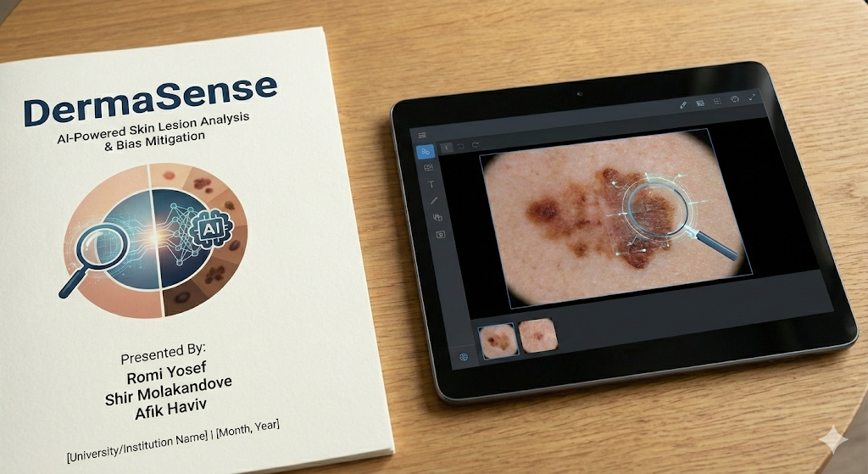

Slide 2

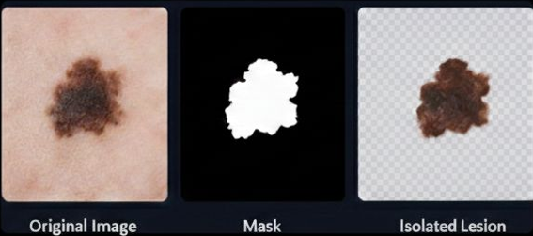
Phase 1: Automated Lesion Isolation
Extracting Diagnostic Artifacts
The first stage of our pipeline focuses on isolating the biological lesion from its original light-skin context. This is critical to ensure that no "light-skin" features pollute the subsequent augmentation.
•
Library: Leveraging the RemBG library for AI-powered background removal.
•
Masking: Creating binary masks using cv2.threshold and cv2.findNonZero to locate precise coordinates.
•
Feature Preservation: By isolating the mole, we preserve the original texture, asymmetry, and color distribution required for ResNet analysis.

Slide 3

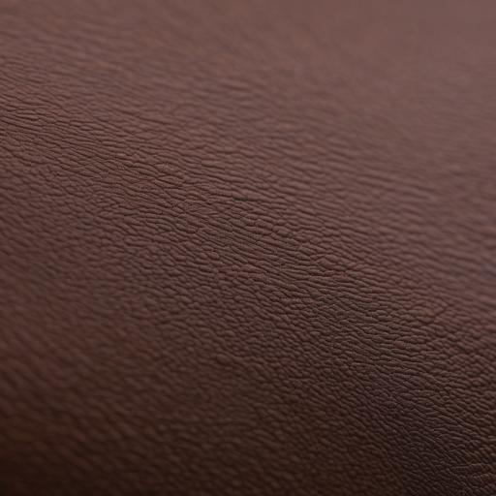

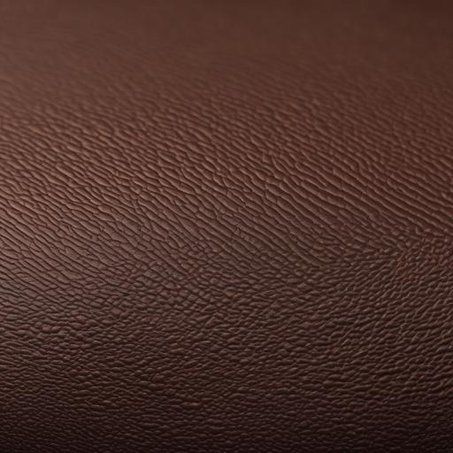
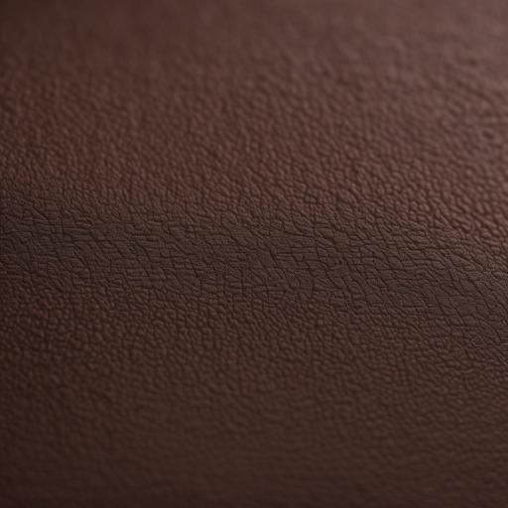
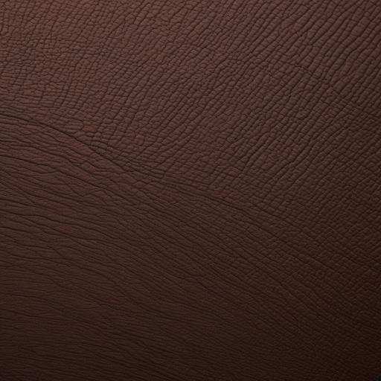
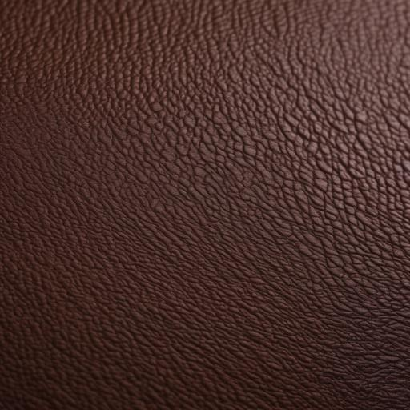
Phase 2: Synthetic Skin Synthesis
Building the 'Digital Skin Bank'
To solve the data scarcity of dark skin tones, we utilize Stable Diffusion XL (SDXL) to generate a diverse library of synthetic backgrounds.
•
Medical Prompts: Custom prompt engineering ensures the generation of clinical-grade textures, including pores, fine lines, and epidermal ridges.
•
Skin Fidelity: We target the Fitzpatrick Scale Type VI to create the most underrepresented skin tone patches.
•
Precision: Images are generated at 1024x1024 resolution and downscaled to match clinical input sizes.

Slide 4
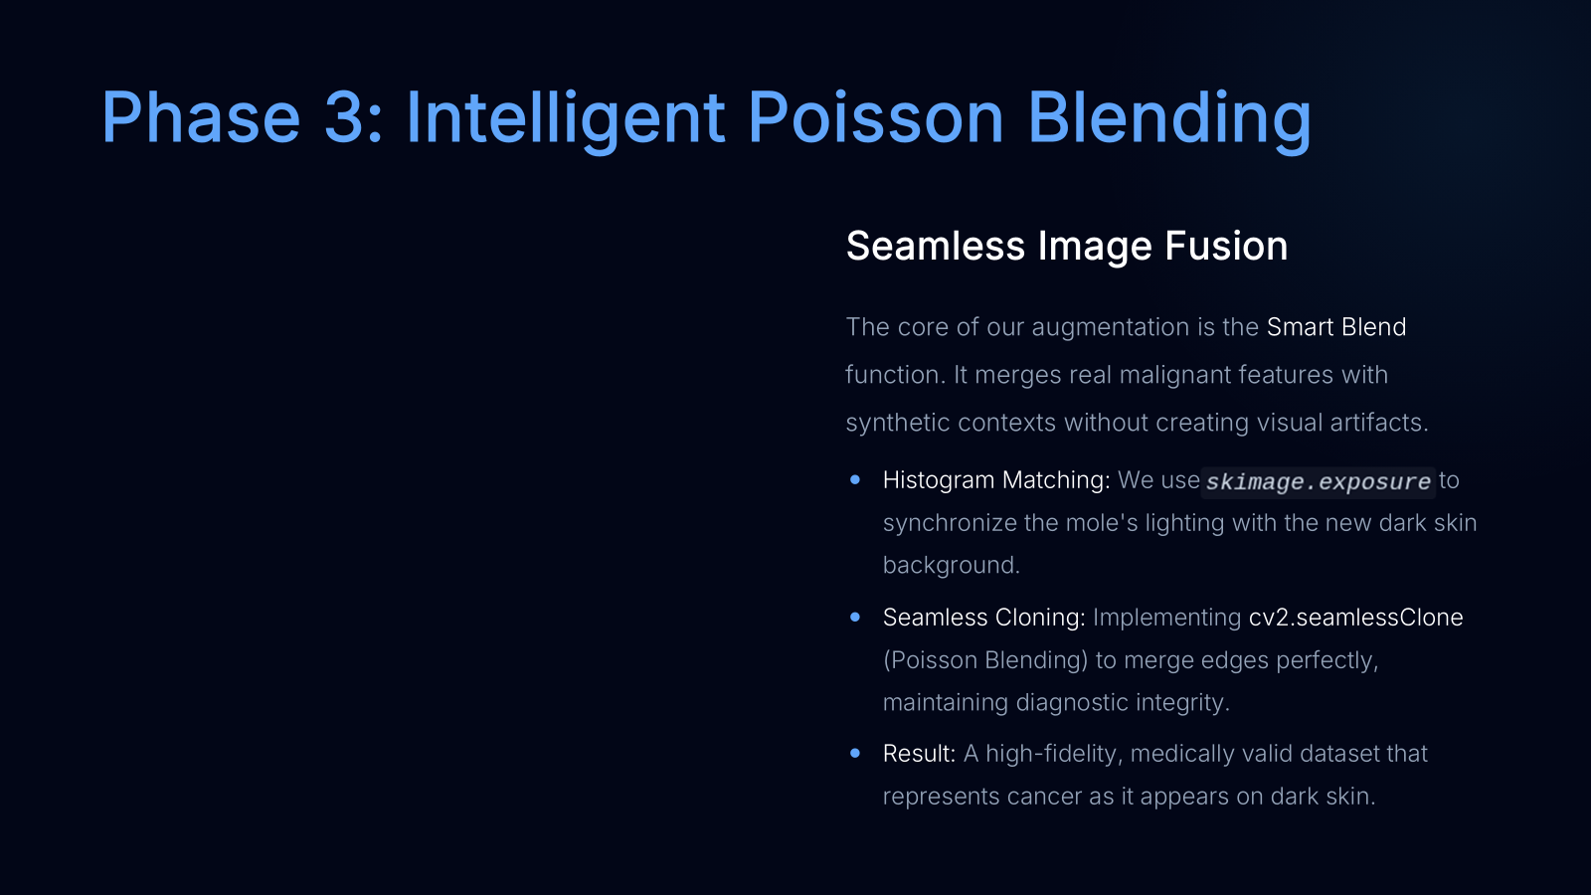
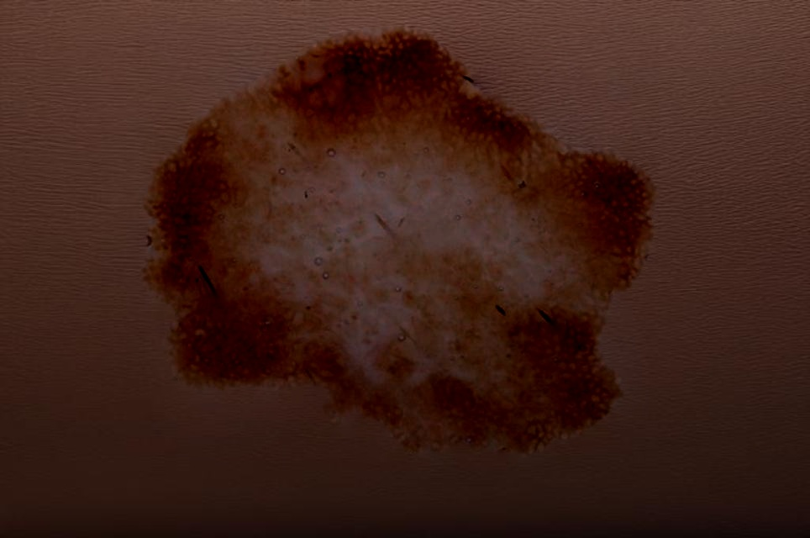
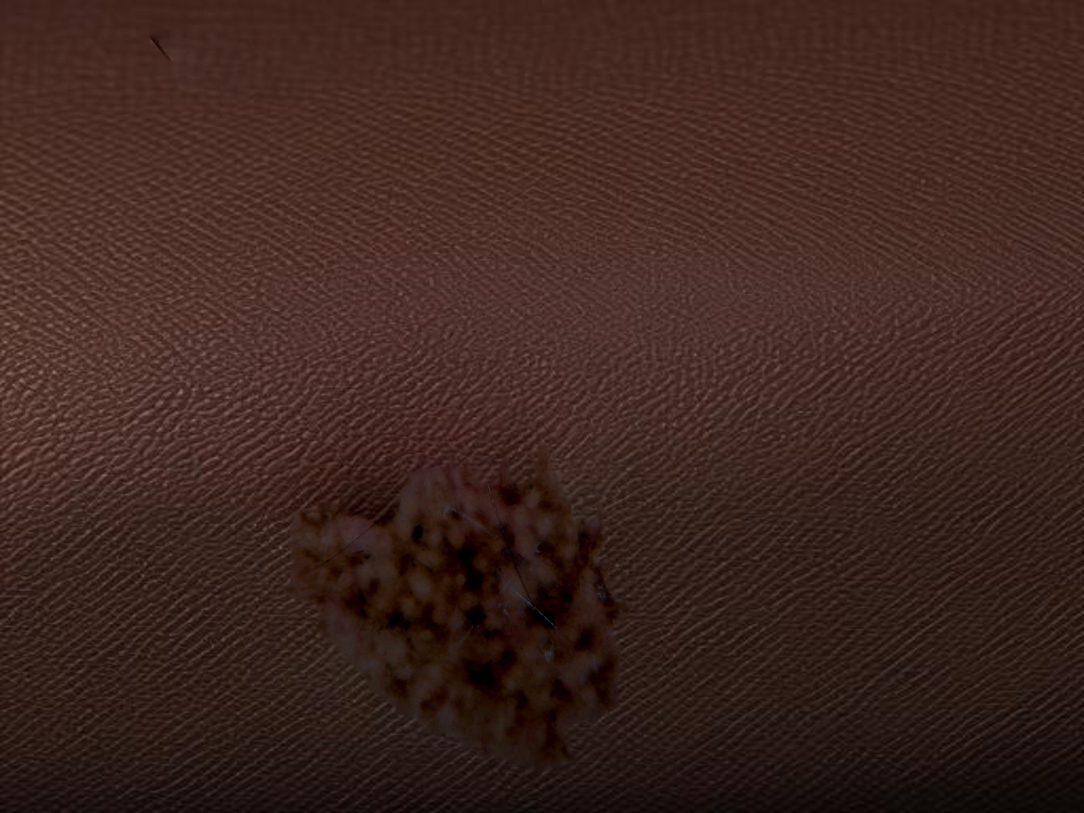
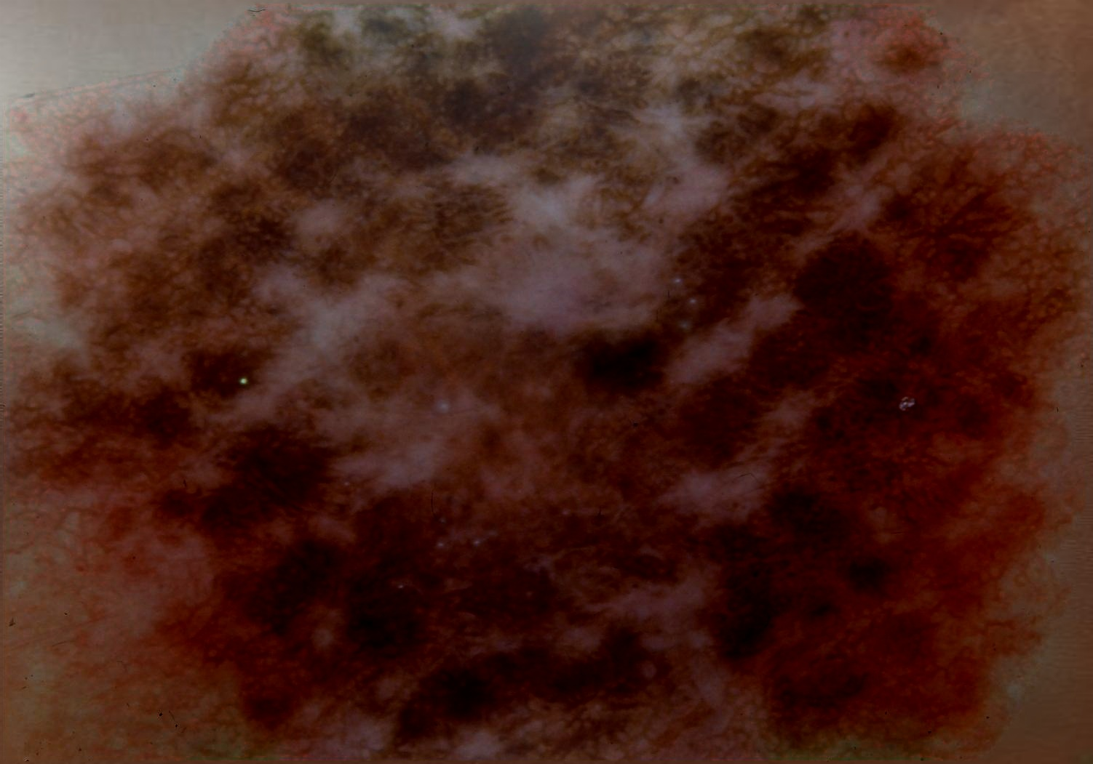
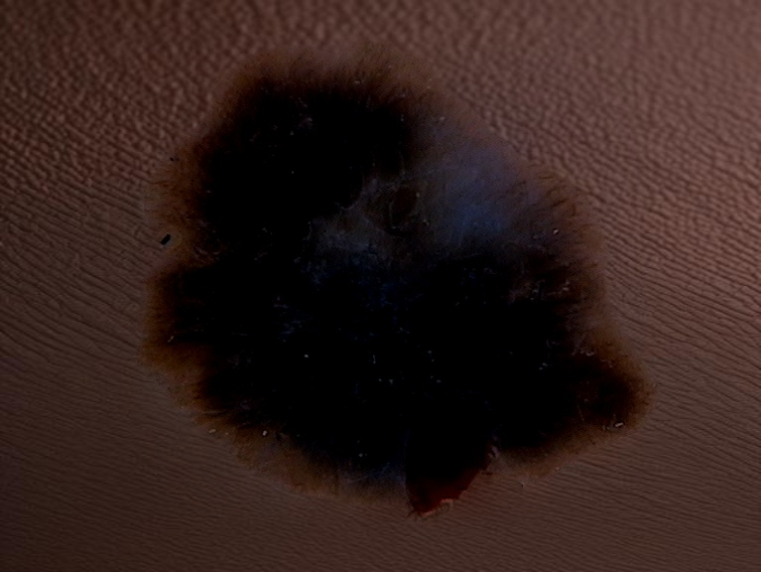

Slide 5
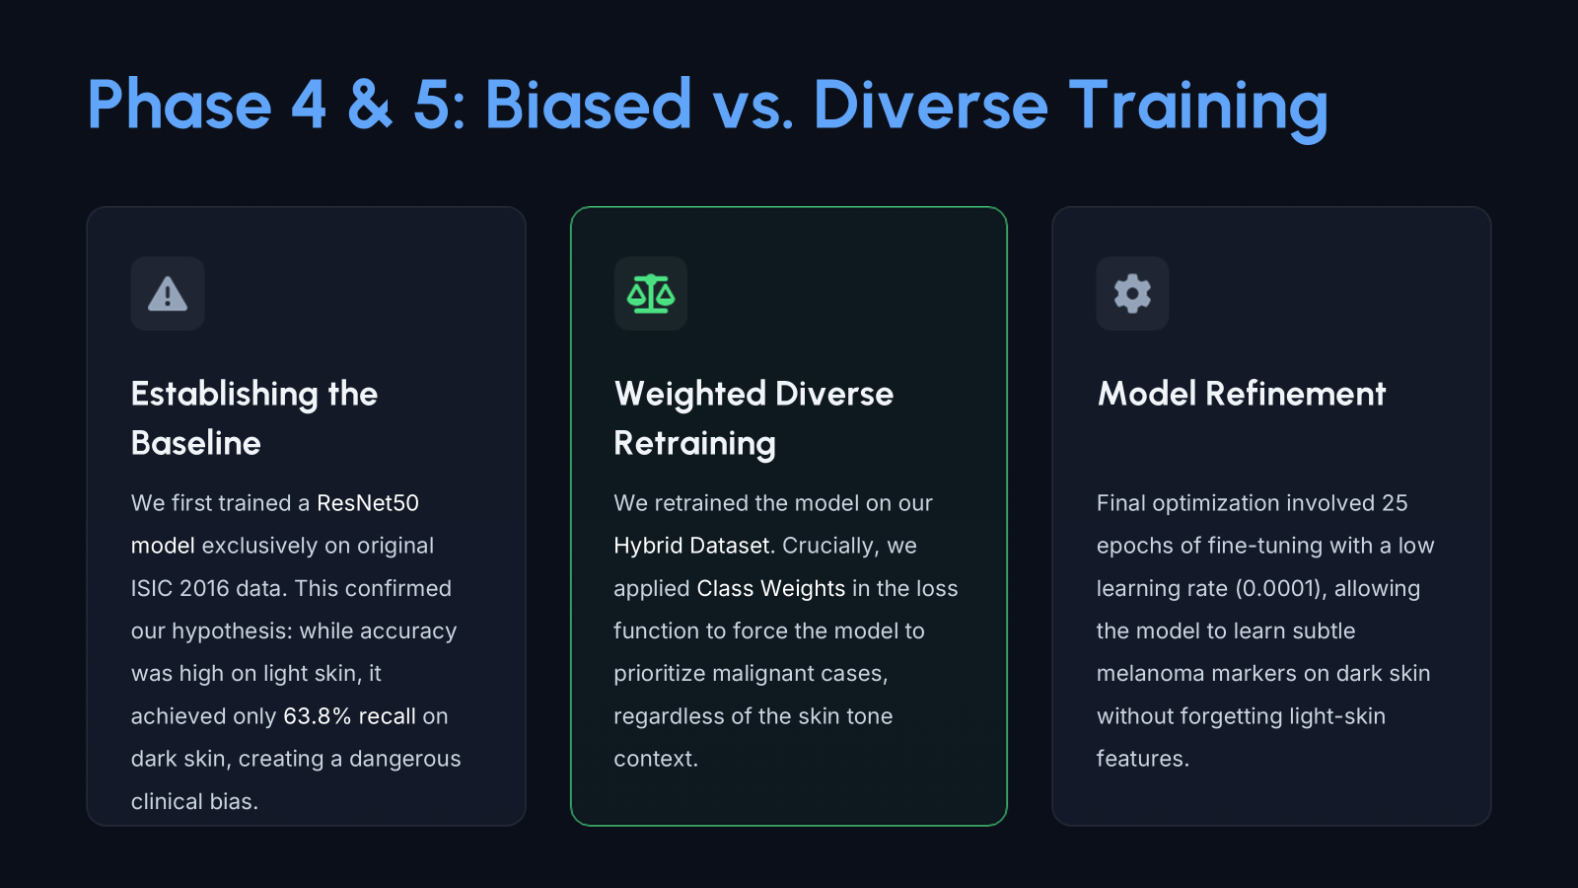

Slide 6
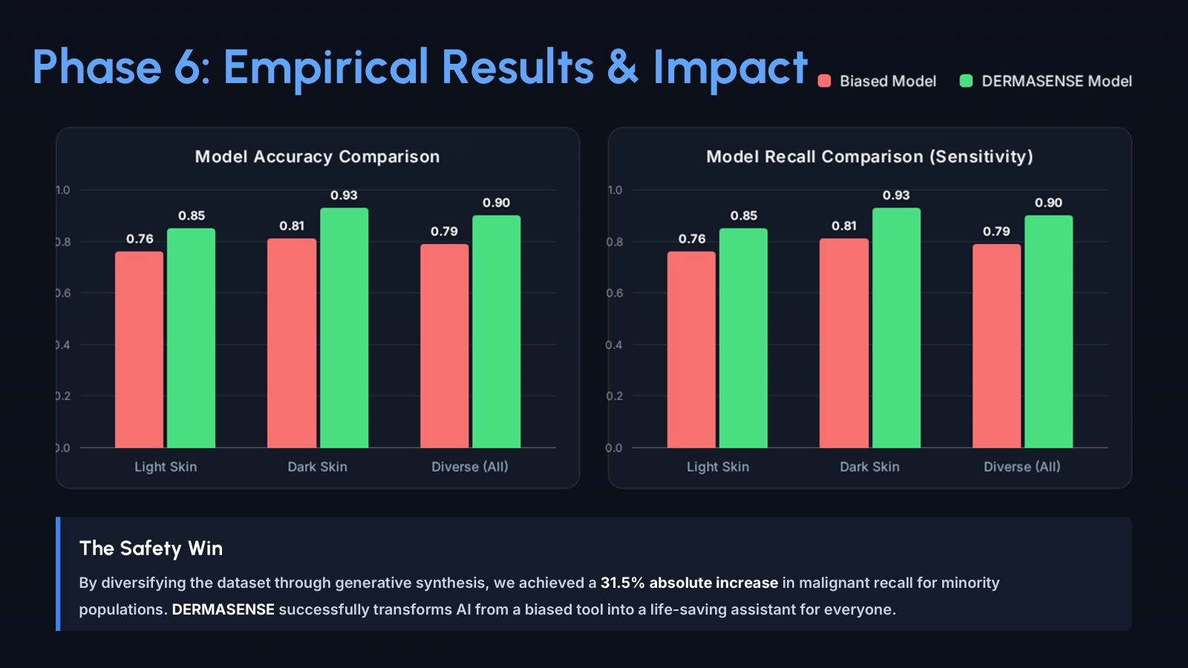

Slide 7
